Slide 1


Introduction to Urban Big Data and Machine Learning
Lecture 15 Machine Learning (II)
Wenzheng Li

Slide 2
Announcement
All assignments (1-4) should be submitted no later than Friday.
Friday Afternoon: 7-10 minutes presentation
Final poster due: Sunday night

Slide 3
OUTLINE
Introduction to Machine Learning
What is machine learning?
Machine learning types
Supervised Learning
Classification and Regression
Unsupervised Learning
Clustering

Slide 4
1
Quick Review

Slide 5
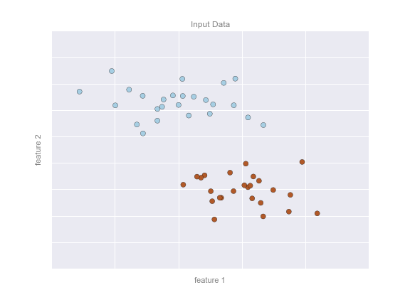
Supervised learning: Classification
Let’s look at some examples

Slide 6
Supervised learning: Classification
Let’s look at some examples
Here, we have a two-dimensional (read: two columns) dataset
We know which dots are blue and which are red.

Slide 7
Supervised learning: Classification
Let’s look at some examples
Here, we have a two-dimensional (read: two columns) dataset
We know which dots are blue and which are red.
The classification question then asks:
Can we create a “separator” model that separates these two points?

Slide 8
Supervised learning: Classification
Model: the quantitative version of “there is a straight line that can separate the two classes”.
Parameters: the intercept and axis (or however else we want to define our line) that describes the line

Slide 9
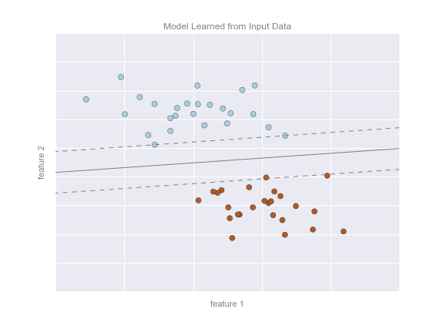
Supervised learning: Classification
So our model could look like this on the right.

Slide 10
Which is classification problem?
An e-commerce company using labeled customer data to predict whether or not a customer will purchase a particular item
A restaurant using review data to ascribe positive or negative sentiment to a given review
A bike share company using time and weather data to predict the number of bikes being rented at any given hour

Slide 11
Which is classification problem?
An e-commerce company using labeled customer data to predict whether or not a customer will purchase a particular item
A restaurant using review data to ascribe positive or negative sentiment to a given review
A bike share company using time and weather data to predict the number of bikes being rented at any given hour

Slide 12
Which is classification problem?
A regression problem is when we try to use any type (continuous or categorical) of data to predict outcomes that are continuous.

Slide 13
Regression vs Classification
A regression problem is when we try to use any type (continuous or categorical) of data to predict outcomes that are continuous.
A classification problem is when we try to use any type (continuous or categorical) of data to predict outcomes that are categorical.

Slide 14
Model Validation: Train-Test Split
Once we have trained our model, i.e. described this function that best separates our two classes (in this case), we can use the model to generalize and make new predictions

Slide 15
Model Validation: Train-Test Split
We typically split our data into train and test sets to evaluate the performance of a model.
The training set is used to find the model
The test set is used to evaluate the performance

Slide 16
Model Validation: Train-Test Split
We want to give the model new, unseen data.
We do this to ensure the model can generalize well.

Slide 17
Model Validation: Train-Test Split
How do we divide the train and test set? No one-size-fits-all rule.
A common breakdown is 70/30 or 80/20 train vs test

Slide 18
Model Validation: Train-Test Split
The split might be determined by:
How big the overall data is. If the data is already pretty small, then you might want a larger training set to get enough data to learn.
If the data is large, perhaps a smaller split is fine.

Slide 19
Model Validation: Train-Test Split
You need to make sure your training data is representative of the larger sample.

Slide 20
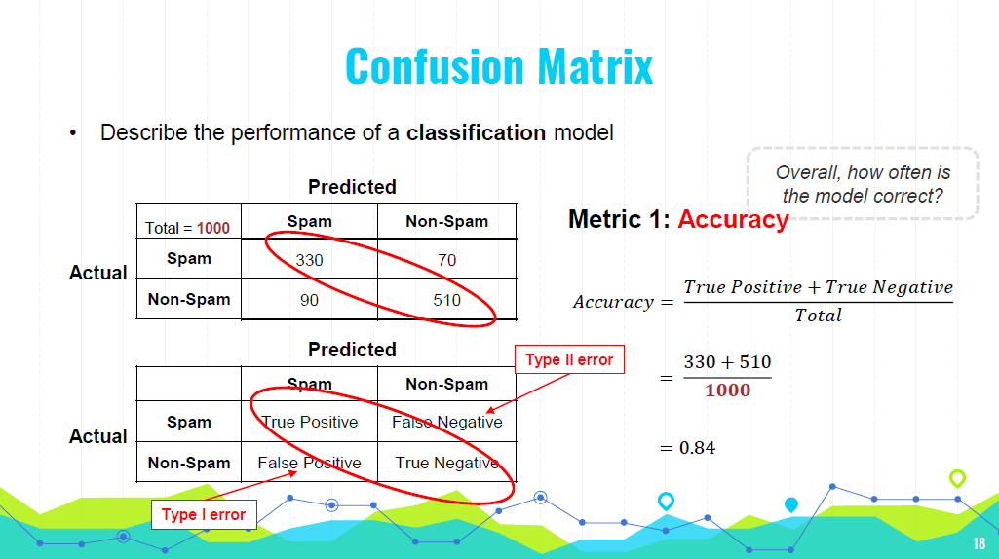
20
Notes:
a Type I error would mean marking a legitimate email as spam. This could result in missing important emails.
In medical testing, it could mean diagnosing a healthy person as having a disease, leading to unnecessary stress and treatment.
a Type II error would mean marking a spam email as legitimate.
In medical testing, it could mean failing to diagnose a person with a disease

Slide 21
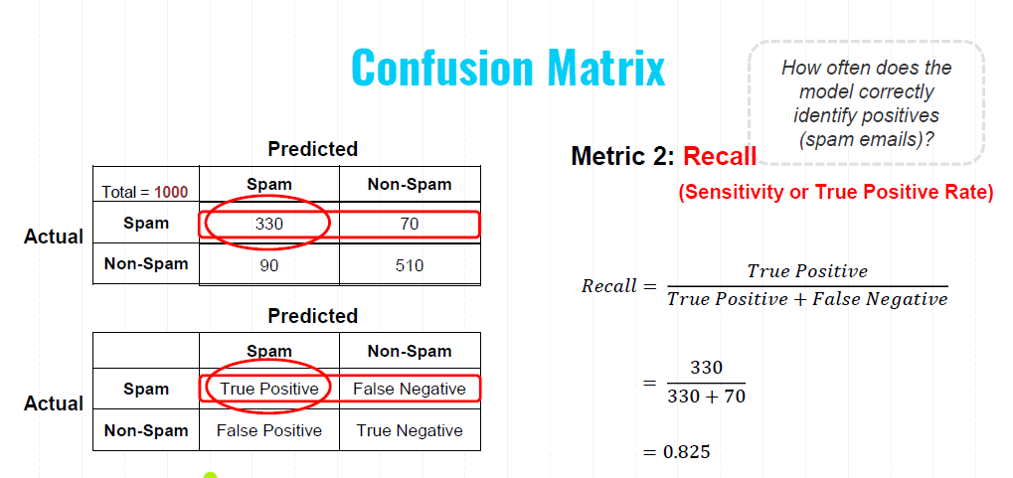
21
Notes:
Recall, also known as sensitivity or the true positive rate, measures how often the model correctly identifies positive instances (in this case, spam emails).

Slide 22
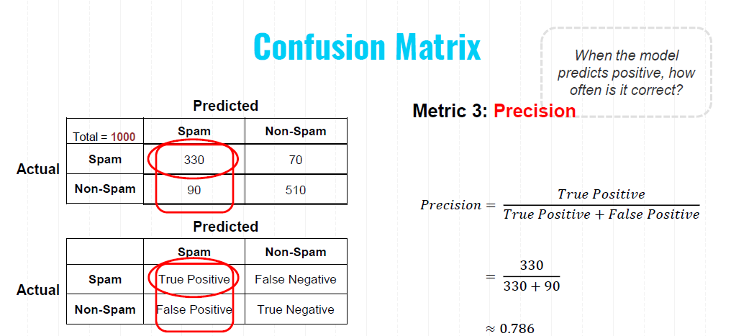
22
Notes:
Precision measures how often the model's positive predictions are correct. It focuses on the quality of the positive predictions made by the model.

Slide 23
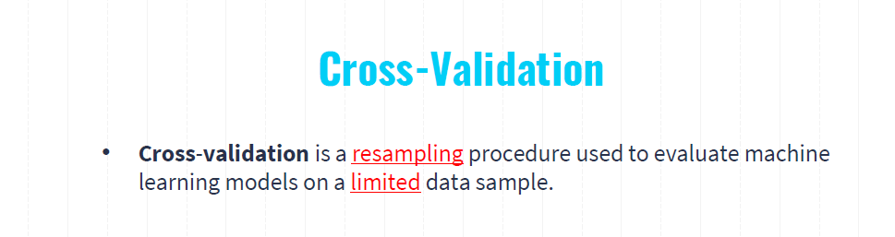
Splitting the Data: The dataset is split into K equal-sized (or nearly equal-sized) subsets.
Training and Validation: The model is trained K times, each time using K-1 folds for training and the remaining 1 fold for validation.
Rotation: The validation fold is rotated such that each of the K folds is used exactly once as the validation set.
Averaging the Results: The performance metric (e.g., accuracy, precision, recall) is averaged across all K trials to give an overall performance estimate.

Slide 24
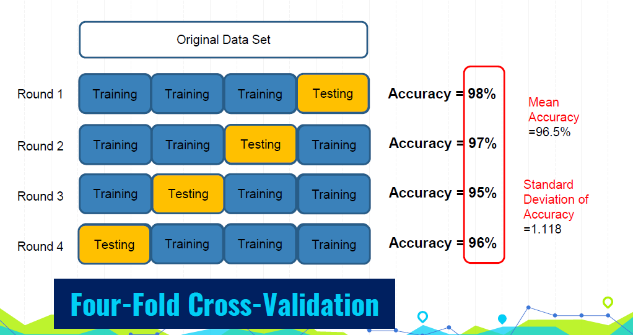
Notes:
Bias-Variance Tradeoff: A larger K results in lower bias but higher variance of the performance estimate. Conversely, a smaller K results in higher bias but lower variance.
Common Choices: Typically, K is set to 5 or 10, as these values have been shown to provide a good balance between computational efficiency and reliable performance estimates.

Slide 25

Hyperparameter Tuning
Hyperparameter: model parameters specified in advance (before training)
What threshold to use?
What k to use?
?
𝒚
?
?
𝒙_{𝟏}
1 Nearest Neighbor
1
𝒙_{𝟏}
0.5
3 Nearest Neighbor
0.3
0
𝒙_{𝟏}
𝒙_{𝟏}
Logistic Regression
K-Nearest Neighbors

Slide 26
Machine Learning Steps
Gathering and loading data
Exploring data (e.g., pandas and visualization)
Transforming data (e.g., string to numeric)
Splitting data for training and testing
Choosing and creating a model
Training
Testing (evaluating accuracy)
Tuning the model (hyperparameters)
Making predictions on new data

Slide 27
2
Supervised Learning Algorithms

Slide 28
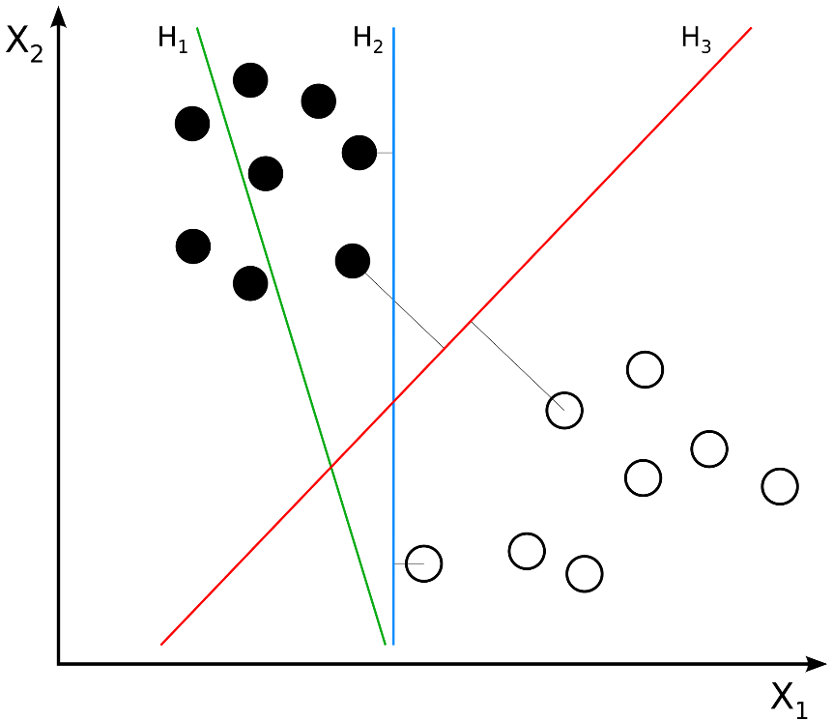
Support Vector Machine
Objective: To find a line or plane (in higher dimensions) that maximizes the distance between the line/plane and the nearest training data points of any class
Key Concept:
The maximum-margin hyperplane.
Margin: the distance between the hyperplane and the closest data points from either class.
These closest points are called support vectors.
margin is maximized equally for both classes.

Slide 29
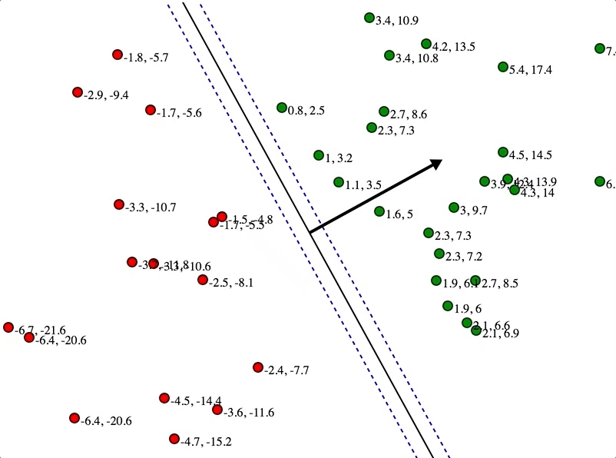
Support Vector Machine
Here, these numbers represent distances to the line
Initial State:
The algorithm starts with an initial guess for the hyperplane.
The algorithm iteratively adjusts the position and orientation of the hyperplane. Tweaking the parameters to improve the separation.
Notes:
Arrow: The black arrow in the image indicates the direction of the maximum margin. It is perpendicular to the hyperplane and shows the vector w\mathbf{w}w, which is the normal to the hyperplane.
Initial State:
Data Points: Initially, the data points (red and green circles) are plotted on the map with no hyperplane drawn.
Objective: The goal is to find the optimal hyperplane that separates the two classes with the maximum margin.
Drawing Initial Hyperplane:
First Attempt: The algorithm starts with an initial guess for the hyperplane. This initial hyperplane may not be optimal and might not maximize the margin.
Iterative Adjustment:
Adjusting the Hyperplane: The algorithm iteratively adjusts the position and orientation of the hyperplane. This involves tweaking the parameters w\mathbf{w}w (weight vector) and bbb (bias term) to improve the separation.
C: Regularization parameter that controls the trade-off between maximizing the margin and minimizing the classification error.Kernel Parameters: If a kernel SVM is used, parameters related to the kernel function (e.g., the gamma parameter in an RBF kernel).

Slide 30
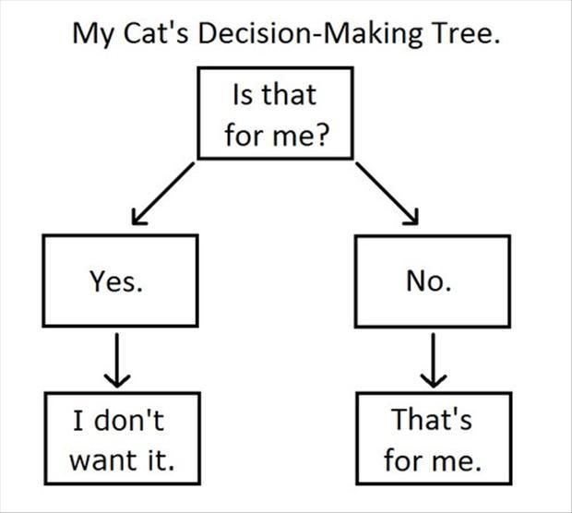
Decision Trees

Slide 31
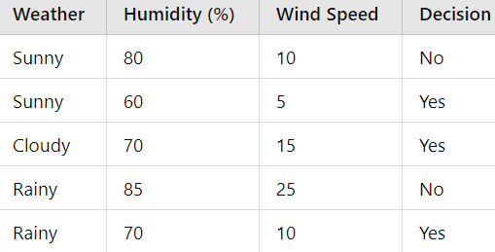
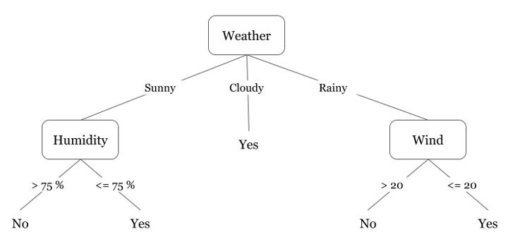
Decision Trees
Did I play badminton for each day of the week?
Decision Tree:
a model that makes decisions by splitting data into subsets based on feature values
each node represents a feature
each branch represents a decision rule
each leaf node represents an outcome
Notes:
Collecting Data: Gather the dataset with features and labels.
Choosing the Best Feature to Split: Use criteria like Gini impurity or information gain to determine the best feature to split the data at each node.
Recursive Splitting: Continue splitting the data at each node until stopping criteria are met (e.g., maximum depth, minimum samples per node).
Prediction: For a new instance, traverse the tree from the root to a leaf based on the feature values of the instance to get the predicted label.
Gini impurity measures the likelihood of an incorrect classification of a randomly chosen element.

Slide 32
Decision Trees
Did I play badminton for each day of the week?
Choosing the Best Feature and threshold to Split:
Gini impurity
Entropy (Information Gain)
Recursive Splitting:
Continue splitting at each node until stopping criteria are met (e.g., maximum depth, minimum samples per node)
Prediction
Notes:
Collecting Data: Gather the dataset with features and labels.
Choosing the Best Feature to Split: Use criteria like Gini impurity or information gain to determine the best feature to split the data at each node.
Recursive Splitting: Continue splitting the data at each node until stopping criteria are met (e.g., maximum depth, minimum samples per node).
Prediction: For a new instance, traverse the tree from the root to a leaf based on the feature values of the instance to get the predicted label.
Gini impurity measures the likelihood of an incorrect classification of a randomly chosen element.

Slide 33
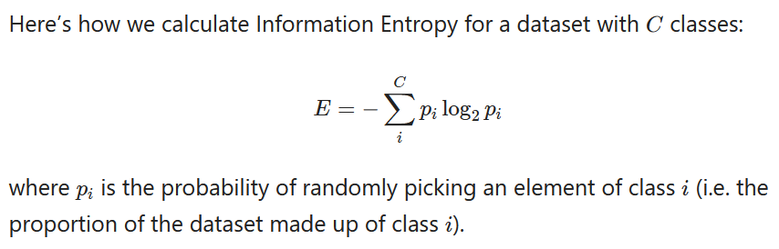
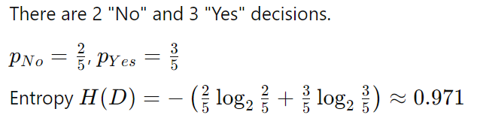
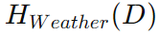
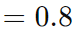
Decision Trees
Did I play badminton for each day of the week?
The Entropy of the root node:
Weighted average entropy for weather:
Information Gain
Notes:
Collecting Data: Gather the dataset with features and labels.
Choosing the Best Feature to Split: Use criteria like Gini impurity or information gain to determine the best feature to split the data at each node.
Recursive Splitting: Continue splitting the data at each node until stopping criteria are met (e.g., maximum depth, minimum samples per node).
Prediction: For a new instance, traverse the tree from the root to a leaf based on the feature values of the instance to get the predicted label.
Gini impurity measures the likelihood of an incorrect classification of a randomly chosen element.

Slide 34
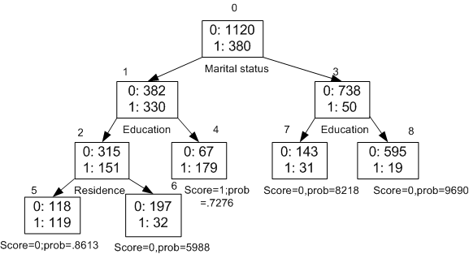
Decision Trees
What causes someone to make big purchases?
the counts of instances that do not make big purchases (0) and those that do (1).
Notes:
Each split aims to separate the data into more homogeneous subsets concerning the target variable (making a big purchase or not).

Slide 35
Decision Trees
What causes someone to make big purchases?
We are going to select a split in the tree that is best able to separate our data into its purest target classes.
Purity: how similar the instances within a subset are in terms of the target variable.
Root node splits: marital status is a significant factor in determining big purchases

Slide 36
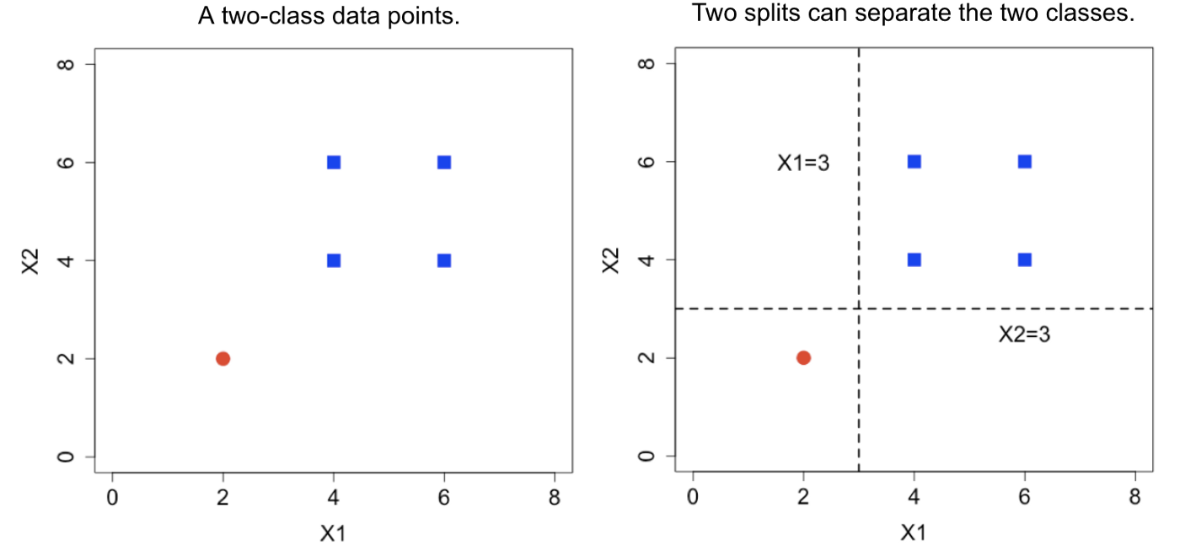
Decision Trees
This is another way to visualize the decision tree
First Split (X1 = 3):
Second Split (X2 = 3)
Notes:
X1 and X2X2X2 are the two features or dimensions of the data.

Slide 37
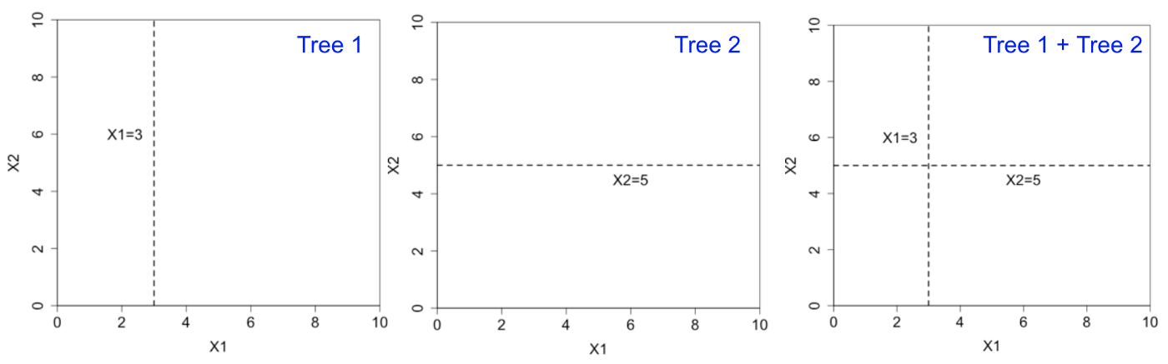
Ensemble Methods: combine the predictions of multiple models
Imagine if we had multiple (typically shallow) trees
Notes:
Ensemble methods combine the predictions of multiple models (typically decision trees) to produce a more accurate and robust prediction. The idea is that multiple models can capture different aspects of the data, and their combined prediction is better than any single model.

Slide 38
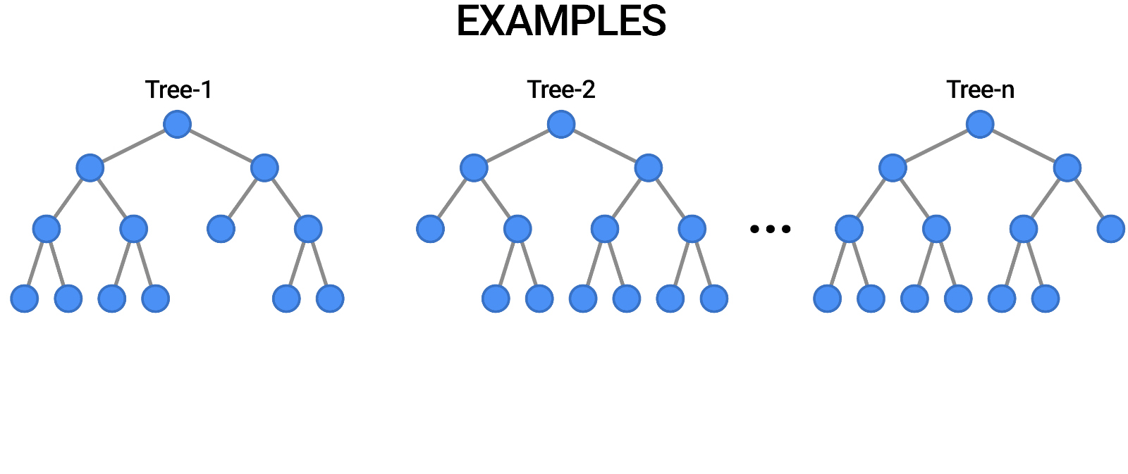
Ensemble Methods: Random Forest
Tree in the random forest is trained on a subset of the data and a random subset of the input features.
So, each tree makes decisions based on a different subset of features.
To predict a new data point, the random forest takes the majority vote of the predictions of all the individual decision trees.
Notes:
This is another way to visu

Slide 39
3
Unsupervised Learning

Slide 40
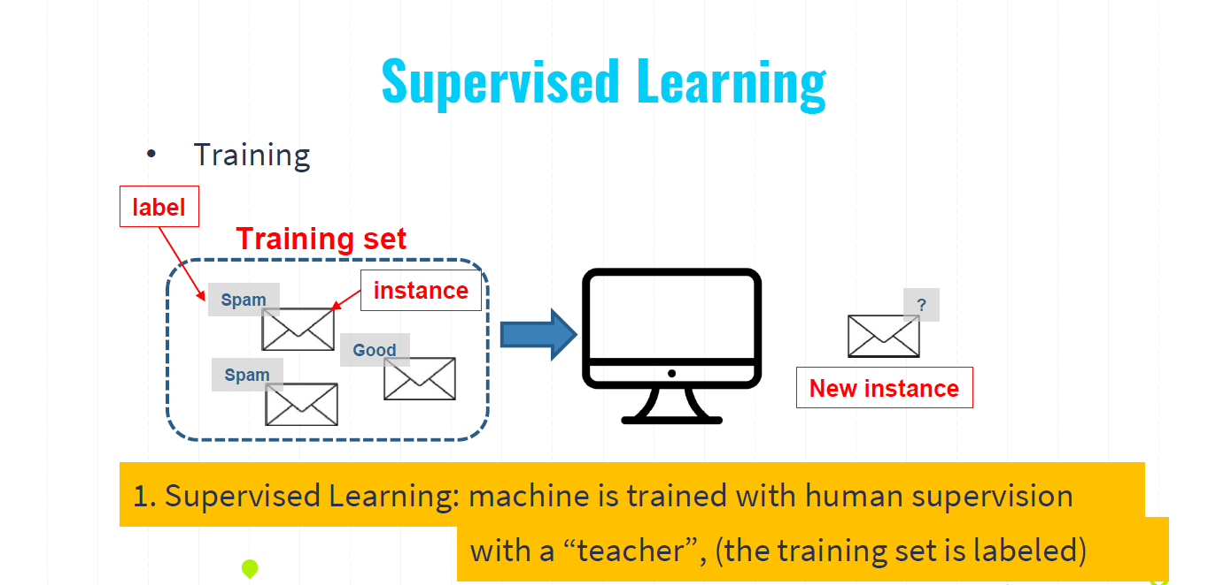

Slide 41
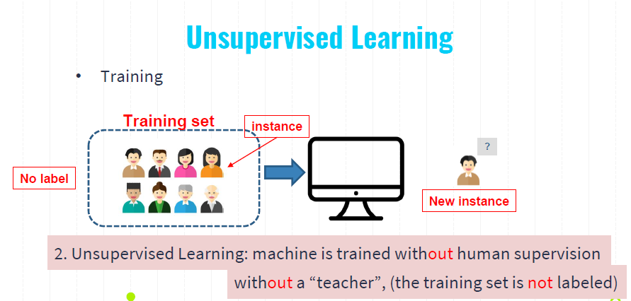

Slide 42
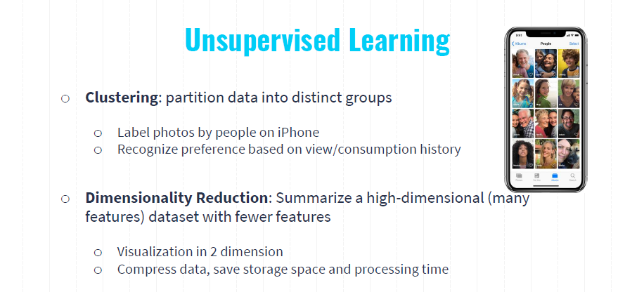

Slide 43
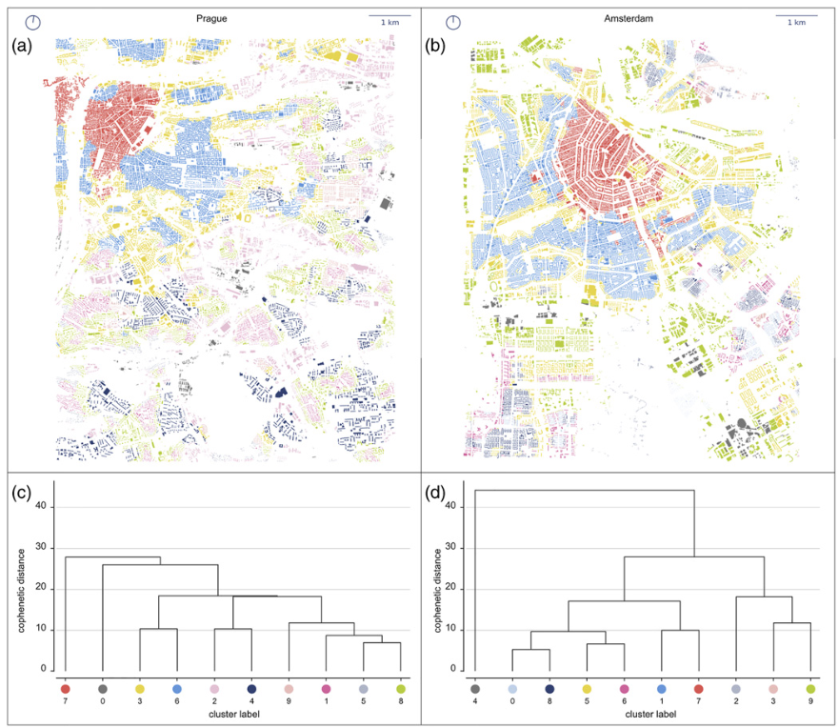
Clustering: partition data into groups
Spatial distribution of detected clusters in central Prague (a) and central Amsterdam (b) accompanied by dendrograms representing the results of Ward’s hierarchical clustering of urban form types in Prague (c) and Amsterdam (d).
Fleischmann, M., Feliciotti, A., Romice, O., & Porta, S. (2022). Methodological foundation of a numerical taxonomy of urban form. Environment and Planning B: Urban Analytics and City Science, 49(4), 1283-1299.

Slide 44
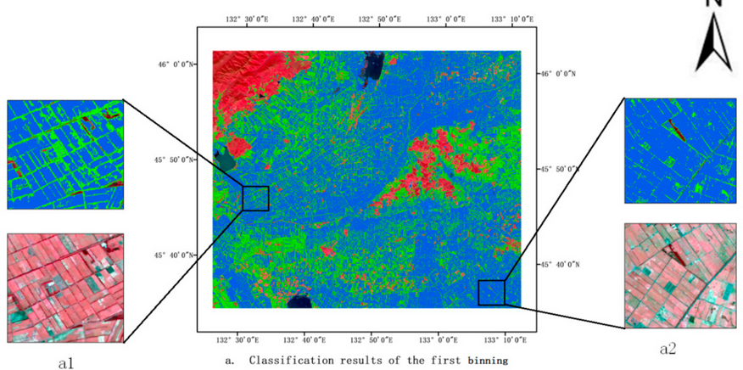
Clustering: partition data into groups
– IsoData imagery classification

Slide 45
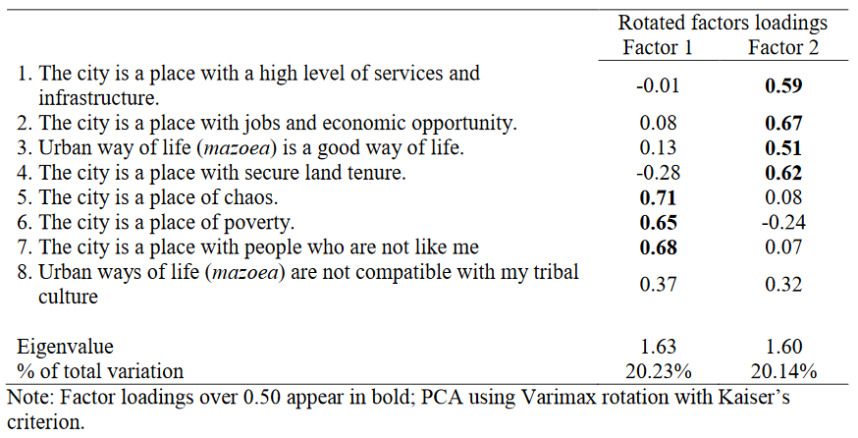
Dimensionality Reduction: Summarize a high-dimensional (many features) dataset with fewer features
Table 4: Summary of rotated factor loadings based on PCA for 8 items on Perception of cities

Slide 46
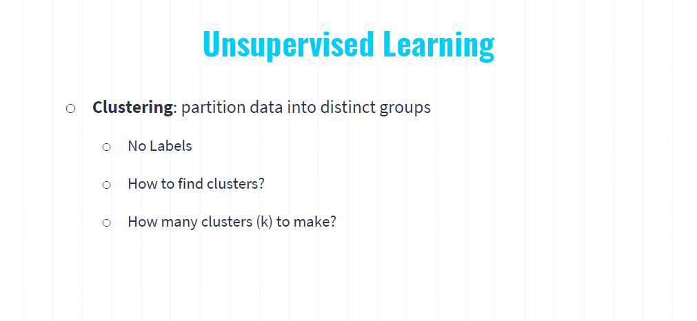

Slide 47
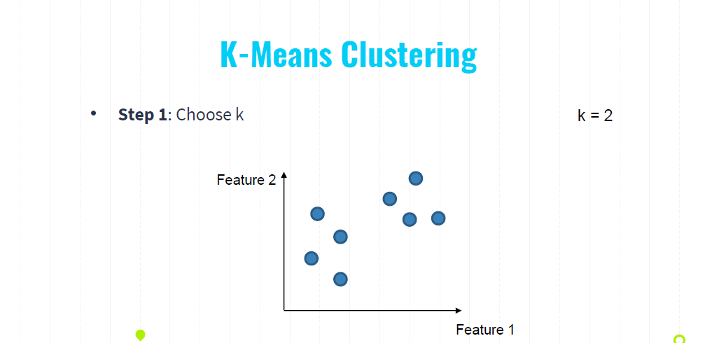
Notes:
You can easily identify by eye, however, how to make computers to do this for us?

Slide 48
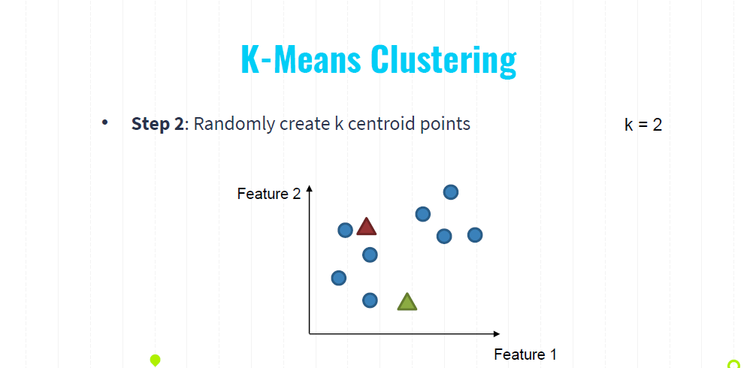

Slide 49
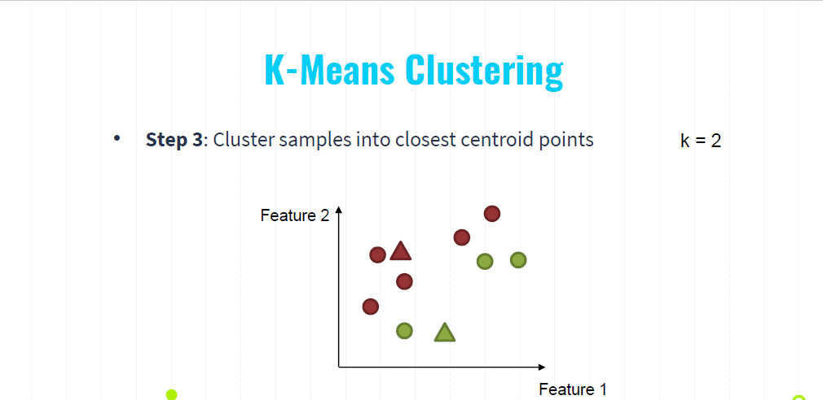

Slide 50
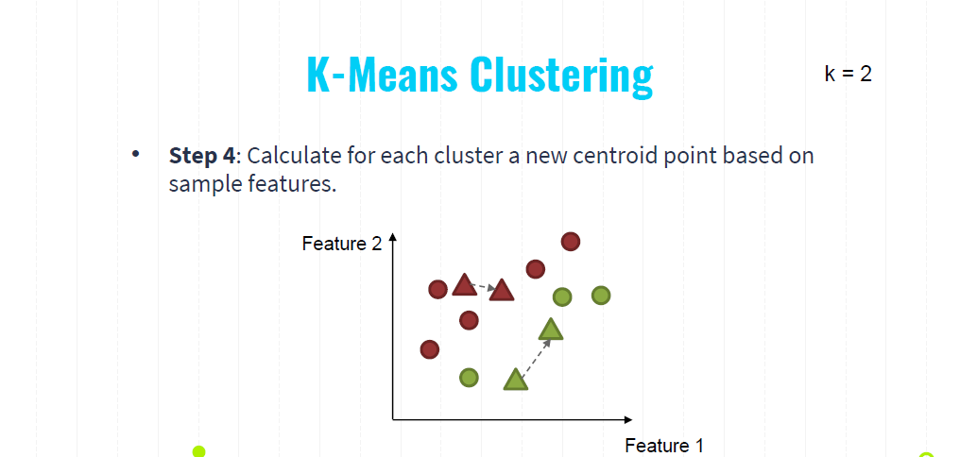

Slide 51
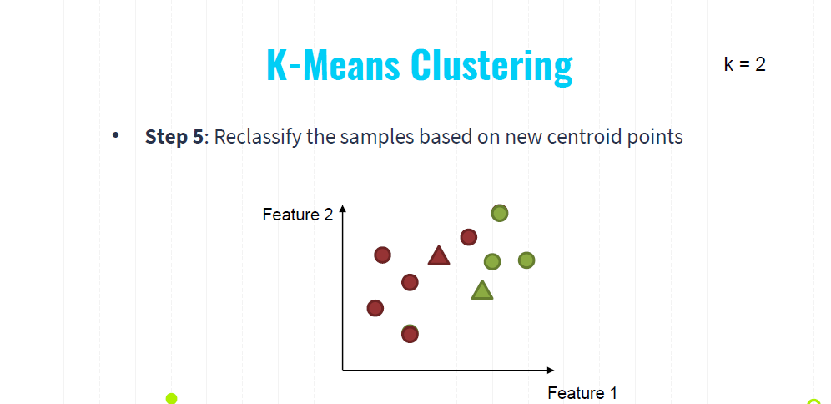

Slide 52
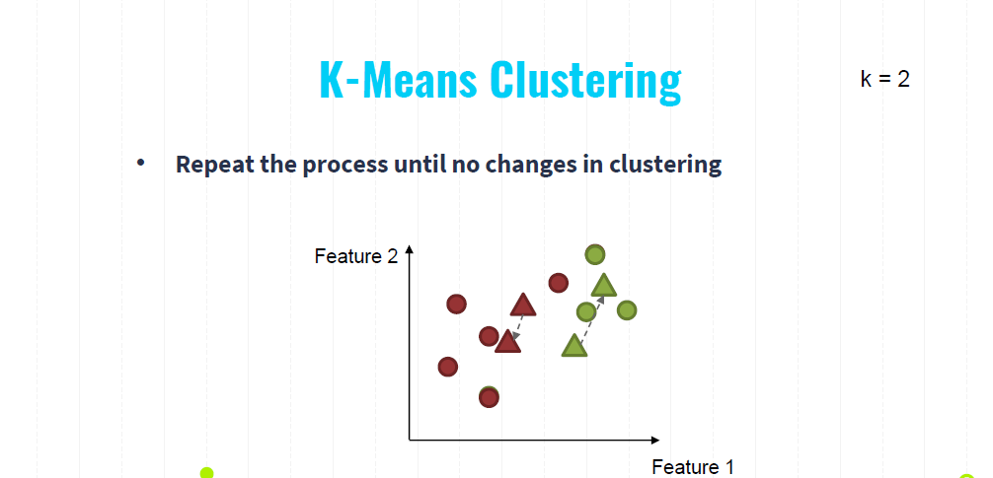

Slide 53
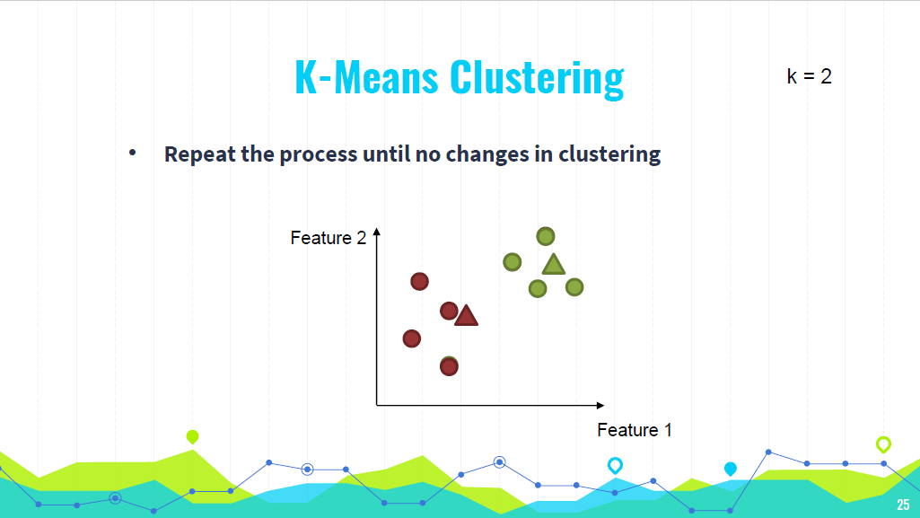

Slide 54
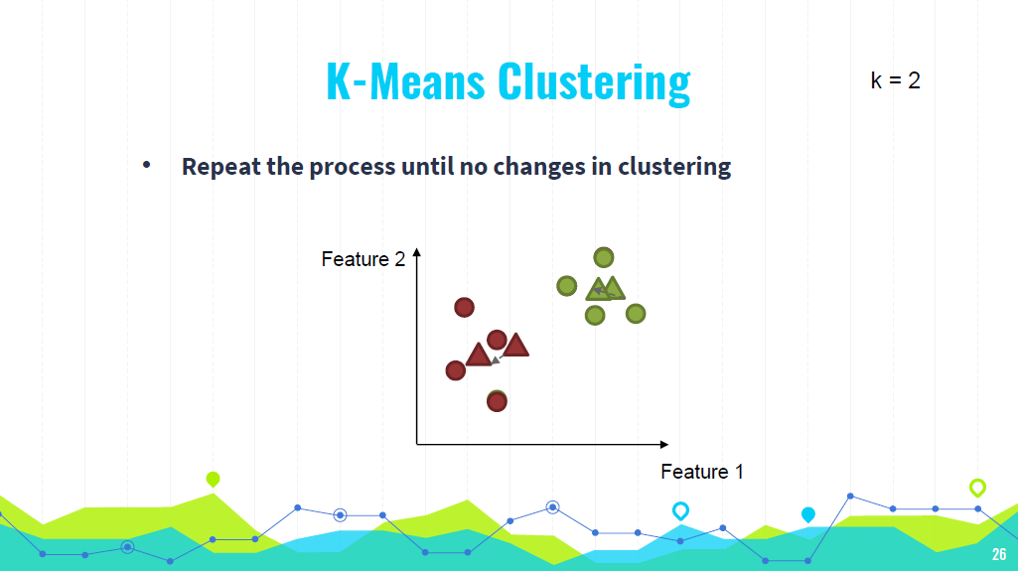

Slide 55
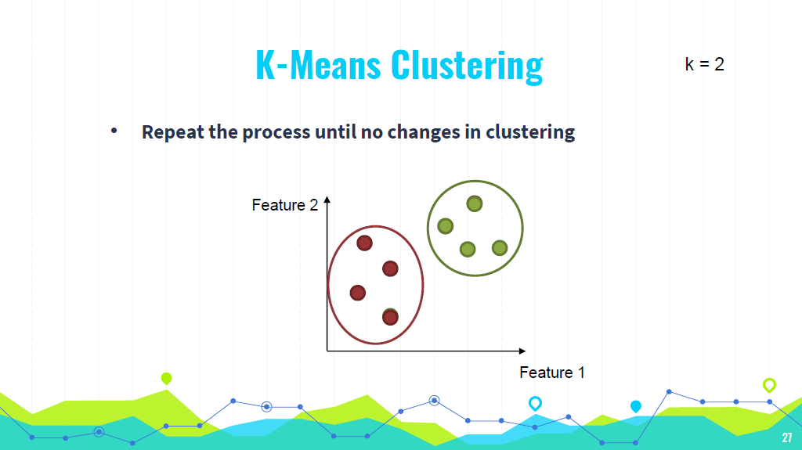

Slide 56
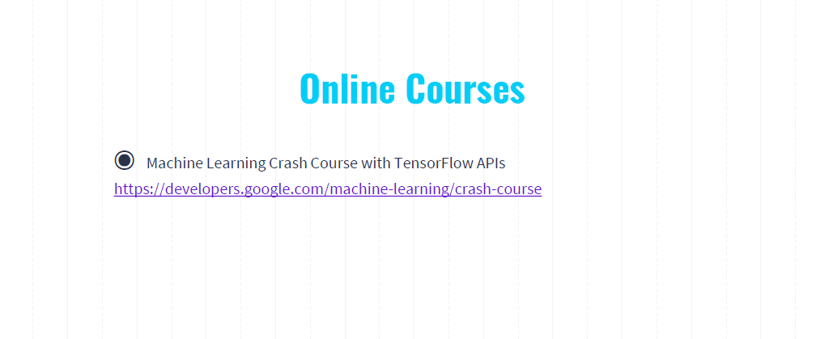
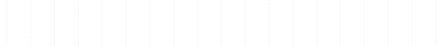
◉Machine Learning Crash Course with TensorFlow APIs
https://developers.google.com/machine-learning/crash-course

Slide 57


Slide 58
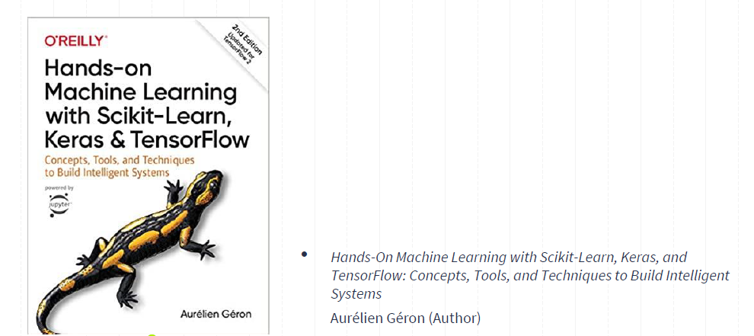

Slide 59
Q&A
Any questions?
You can find me at
wl563@cornell.edu
59

